Slide 1
Handwritten to DIGITAL TEXT
Guided by: Prof Maahi Ma’am
Group Members:-
38-Mihir Narkar
49-Purva Pawar
63-Jatin Tiwari

Slide 2
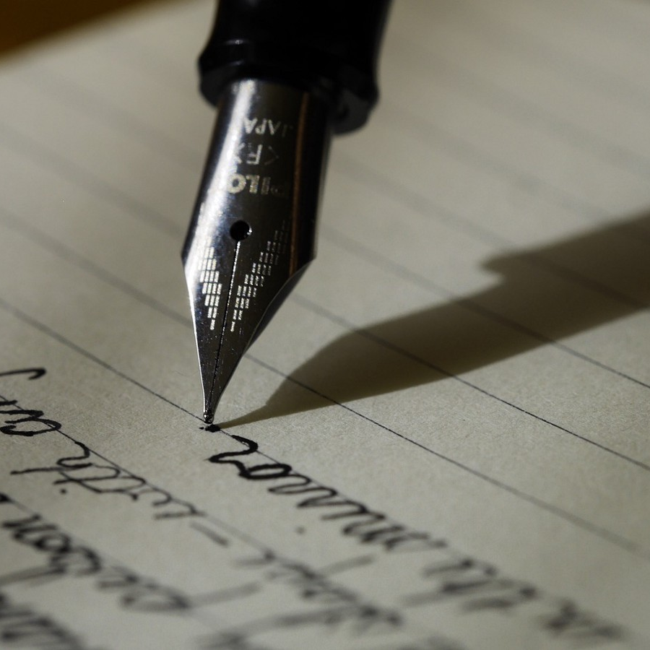
Agenda
Introduction
Tools
Problem statement
Layouts
Challenges
Conclusion

Slide 3
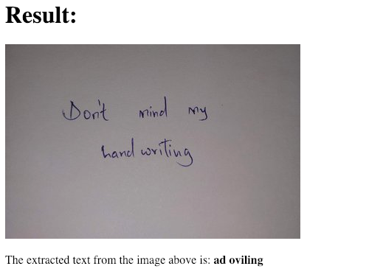
Introduction
In the field of Machine Learning, recognition of objects has become the most sought one. Some of the examples of object recognition are image recognition, face recognition, etc.
Handwriting recognition is a new technology that will be useful in this 21st century. It can act as base functionality for the birth of new requirements.
For example:- a blind man cannot read a newspaper unless braille format exists. In this case we can train the algorithm to recognize characters in the news paper, store them as text and convert the text to speech.

Slide 4
Libraries and Tools
Libraries:
Tkinter
Cv2
Numpy
Pillow
Tool:
(1) Pytesseract

Slide 5
Problem Statement
Printed text does not often succeed for either the recognition of natural scene text.
It is challenging to recognize image
It is still challenging due to the large variance

Slide 6
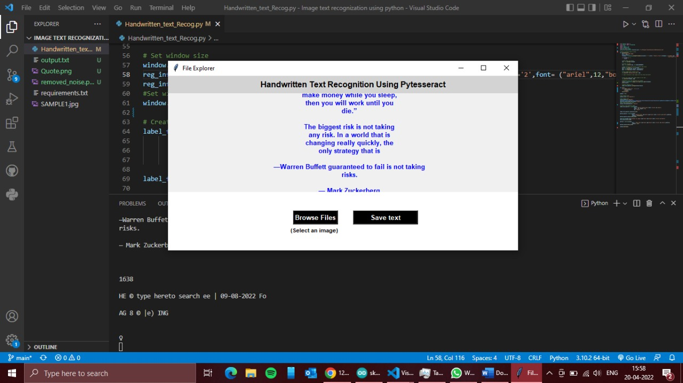
Proposed System Layouts

Slide 7
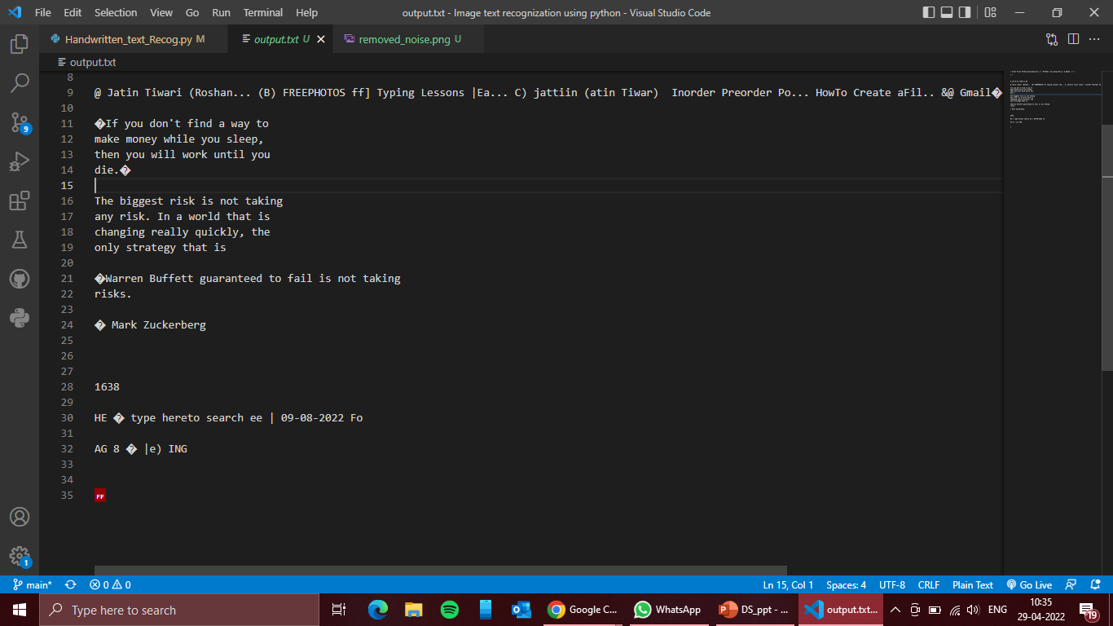

Slide 8
Challenges
Huge variability and ambiguity of strokes from person to person
Handwriting style of an individual person also varies time to time and is inconsistent
Cursive handwriting makes separation and recognition of characters challenging
Collecting a good labelled dataset to learn is not cheap compared to synthetic data

Slide 9
Conclusion
Traditional OCR used to work similar to biometric device.
Photo sensor technology was used to gather the match points of physical attributes and then convert it into database of known types.
A further application of accurate text OCRs is to help the partially sighted and the blind in the absence of braille.

Slide 10
Thank You

